Slide 1




Introduction to Spotify Trends Analysis
Spotify is a leading music streaming platform with a wealth of data on global listening trends. Analyzing this data provides valuable insights into emerging artists, genre popularity, and user listening habits over time.
by SASIKUMAR SHA

Slide 2

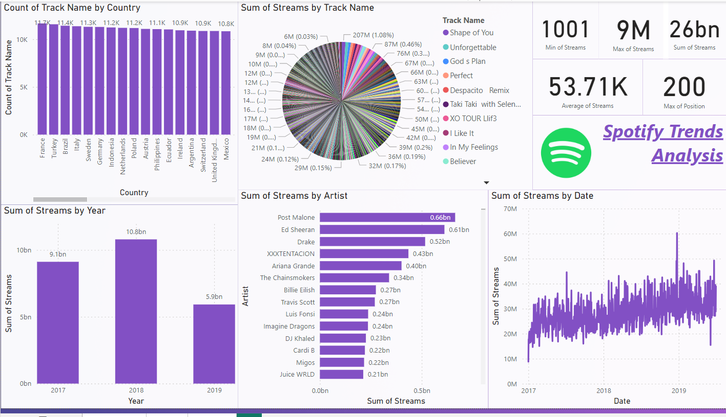
Overview of Spotify's Streaming Data
1
Artist Popularity
“Post Malone” had the highest sum of streams in the year of 2018 in the country of the United States. “Manqonqo” is the lowest-streamed
2
Tracker Popularity
The highest played tracker is “Shape of You” played by Ed Sheeran in the year of 2017 in Argentina. Where “Dayfly” is the lowest played tracker
3
Playlist Performance
In the year of 2018 had highest stream and lowest stream in the year of 2017

Slide 3
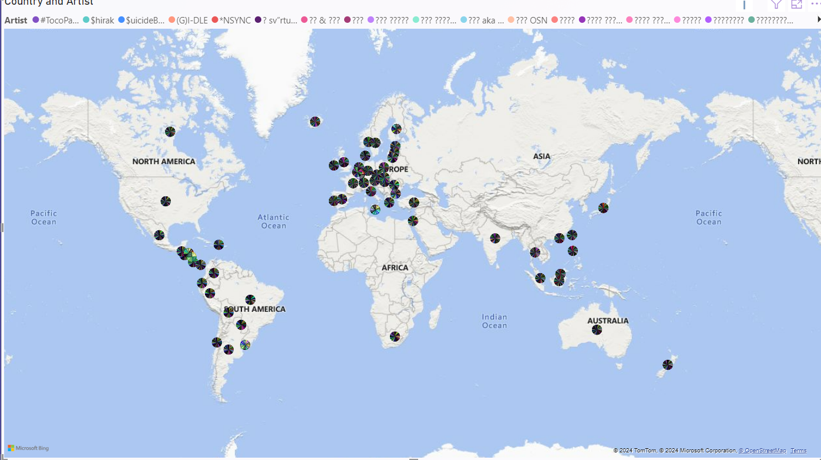
Analyzing Spotify’s Trends
Sum of streams trended up, resulting in 342% increase between Jan 1 2017 to July 2019
Sum of streams started trending up Sunday Jan 1 2017, rising 118.32% in 24 days.
At 11660, France had the highest count of tracker name and was 5672.28% higher than Luxembourg, which had lowest count of tracker at 202.
France had the highest count of tracker name at 11660 followed by Turkey and Brazil, Luxembourg had the lowest count of tracker name at 202

Slide 4

Conclusion and Key Takeaways
Total Streams
Max of Streams -9M
Min of Steams - 1001
Average of Streams -53.71k
Max of position – 200
Sum of Steams – 26bn
In the year of 2018
Max of Streams – 9M
Min of Steams - 1001
Average of Streams – 55.49k
Max of position - 200
Sum of Steams – 11bn
In the year of 2017
Max of Streams – 8M
Min of Steams - 1001
Average of Streams – 50.15k
Max of position - 200
Sum of Steams – 9bn
In the year of 2019
Max of Streams – 9M
Min of Steams - 1001
Average of Streams – 56.56k
Max of position - 200
Sum of Steams – 6bn

